Slide 1
Neural Networks

Slide 2




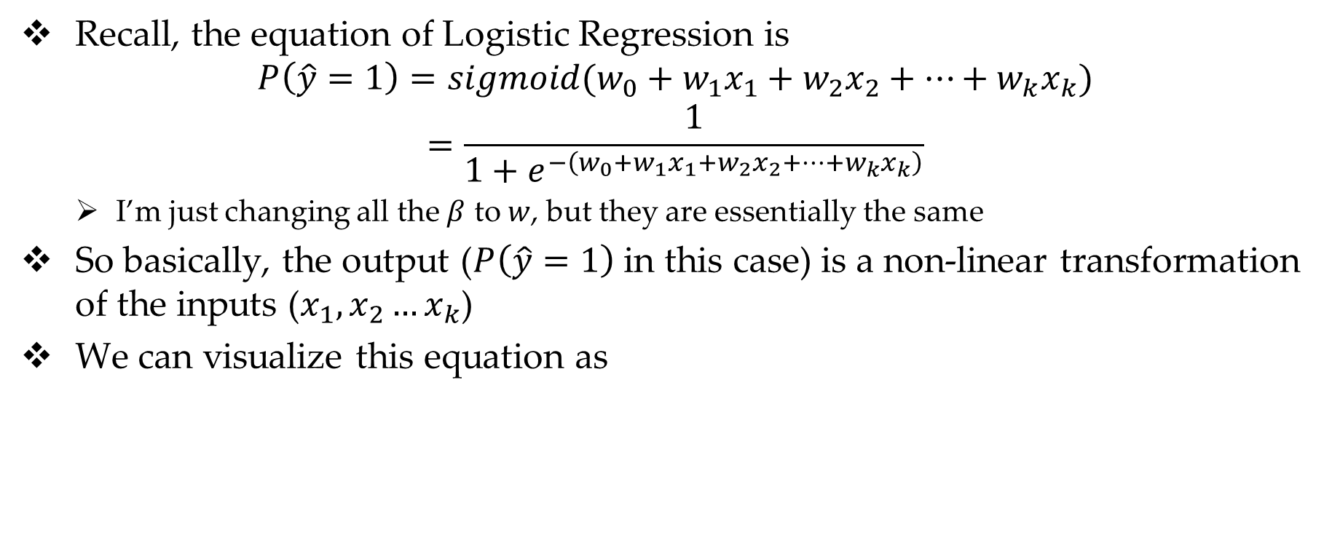






Review on Logistic Regression
Recall, the equation of Logistic Regression is
$$P\left(\hat{y}=1\right)=sigmoid(w_{0}+w_{1}x_{1}+w_{2}x_{2}+…+w_{k}x_{k})$$
$$=\frac{1}{1+e^{−\left(w_{0}+w_{1}x_{1}+w_{2}x_{2}+…+w_{k}x_{k}\right)}}$$
I’m just changing all the $β$ to $w$, but they are essentially the same
So basically, the output ($P\left(\hat{y}=1\right)$ in this case) is a non-linear transformation of the inputs ($x_{1},x_{2}…x_{k}$)
We can visualize this equation as
$$P$$
$$w_{0}$$
$$w_{1}$$
$$w_{2}$$
$$w_{3}$$
$$w_{k}$$
1
$$x_{1}$$
$$x_{2}$$
$$x_{3}$$
$$x_{k}$$

Slide 3



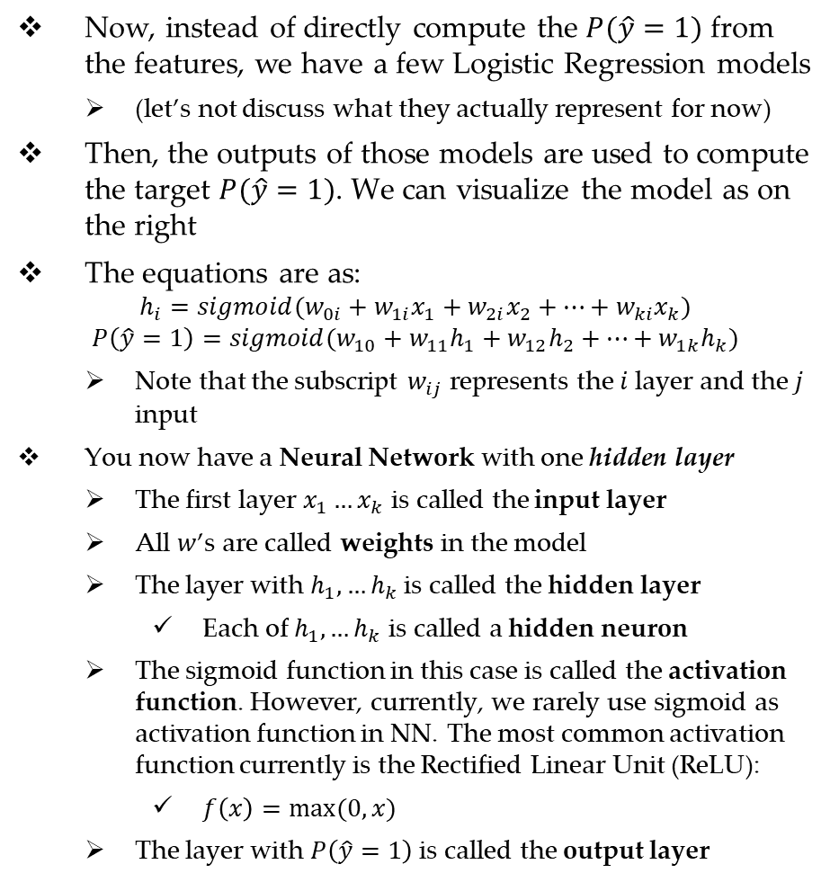





Adding a Layer
Now, instead of directly compute the $P(\hat{y}=1)$ from the features, we have a few Logistic Regression models
(let’s not discuss what they actually represent for now)
Then, the outputs of those models are used to compute the target $P(\hat{y}=1)$. We can visualize the model as on the right
The equations are as:
$$h_{i}=sigmoid(w_{0i}+w_{1i}x_{1}+w_{2i}x_{2}+…+w_{ki}x_{k})$$
$$P\left(\hat{y}=1\right)=sigmoid(w_{10}+w_{11}h_{1}+w_{12}h_{2}+…+w_{1k}h_{k})$$
Note that the subscript $w_{ij}$ represents the $i$ layer and the $j$ input
You now have a Neural Network with one hidden layer
The first layer $x_{1}…x_{k}$ is called the input layer
All $w$’s are called weights in the model
The layer with $h_{1},…h_{k}$ is called the hidden layer
Each of $h_{1},…h_{k}$ is called a hidden neuron
The sigmoid function in this case is called the activation function. However, currently, we rarely use sigmoid as activation function in NN. The most common activation function currently is the Rectified Linear Unit (ReLU):
$f\left(x\right)=max⁡(0,x)$
The layer with $P\left(\hat{y}=1\right)$ is called the output layer
$$P$$
1
$$h_{1}$$
$$h_{2}$$
$$h_{k}$$
1
$$x_{1}$$
$$x_{2}$$
$$x_{3}$$
$$x_{k}$$

Slide 4
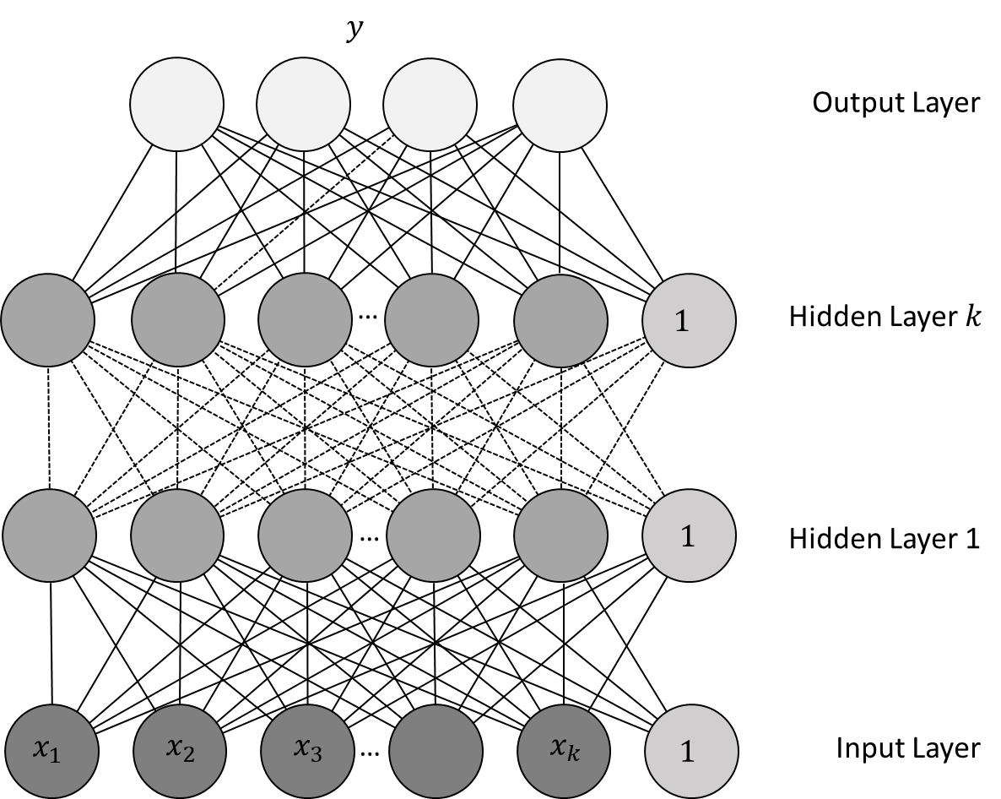
Neural Network
From the previous example, we can generalize a Neural Network as a multi-layer model
Each layer is computed as a non-linear transformation of the previous layer
The number of hidden layers and the number of hidden neurons per layer are hyper-parameters to be finetuned
The model in the output layer depends on the task, most commonly
Logistic regression for Binary Classification
SoftMax regression for Multi-label Classification
Linear regression for regression
A NN is also called a Multi-Layer Perceptron (MLP)
Similar to other machine learning models, MLP is trained to minimize a training objective, and would need regularization to prevents the weights from getting extreme values

Slide 5
Why Have Multiple Layers?
Similar to a linear regression model, a single Logistic regression model cannot handle non-linearity in the data (with respect to the binary classification problem)
Adding a hidden layer between the input features and model output provides the model some capabilities of handling non-linearities
So, adding more hidden layers makes the model more robust to non-linearities in the data
Roughly speaking, each hidden layer transform the input data to a higher-level representation.
So with many hidden layers, the input data is transformed into a very high-level representation that is optimized for the problem, and thus increase model performance
NN with more than three hidden layers are called Deep Neural Networks
However, there is a trade-off – the deeper a model, the more difficult it is to train

Slide 6
Finetuning a NN/MLP
As you can see, NN models have two important hyper-parameters
Number of hidden layers
Number of neurons in each layers
This makes NNs a bit trickier to train – there are two many possibilities for these hyperparameters
Some of my personal experiences with DNN:
Deeper models are more prone to overfitting, but also are more difficult to train
Wider models (i.e. more neurons per layers) are easier to train but also easier to overfit the data
In general, we usually train networks with three to five hidden layers
The numbers of neurons in each layer are not necessarily equal to each other, however I usually use equal numbers, and also equal to a factor of number of input features
For example, if we have 5 input features, then each layer may have 5, 10, 15, or 20 neurons
In sklearn, NNs are quite a bit slower to train than other models. So you should limit the number of architectures to try, especially when the data is large
In sklearn, we use MLPClassifier for classification, and MLPRegressor for regression

